Slide 1
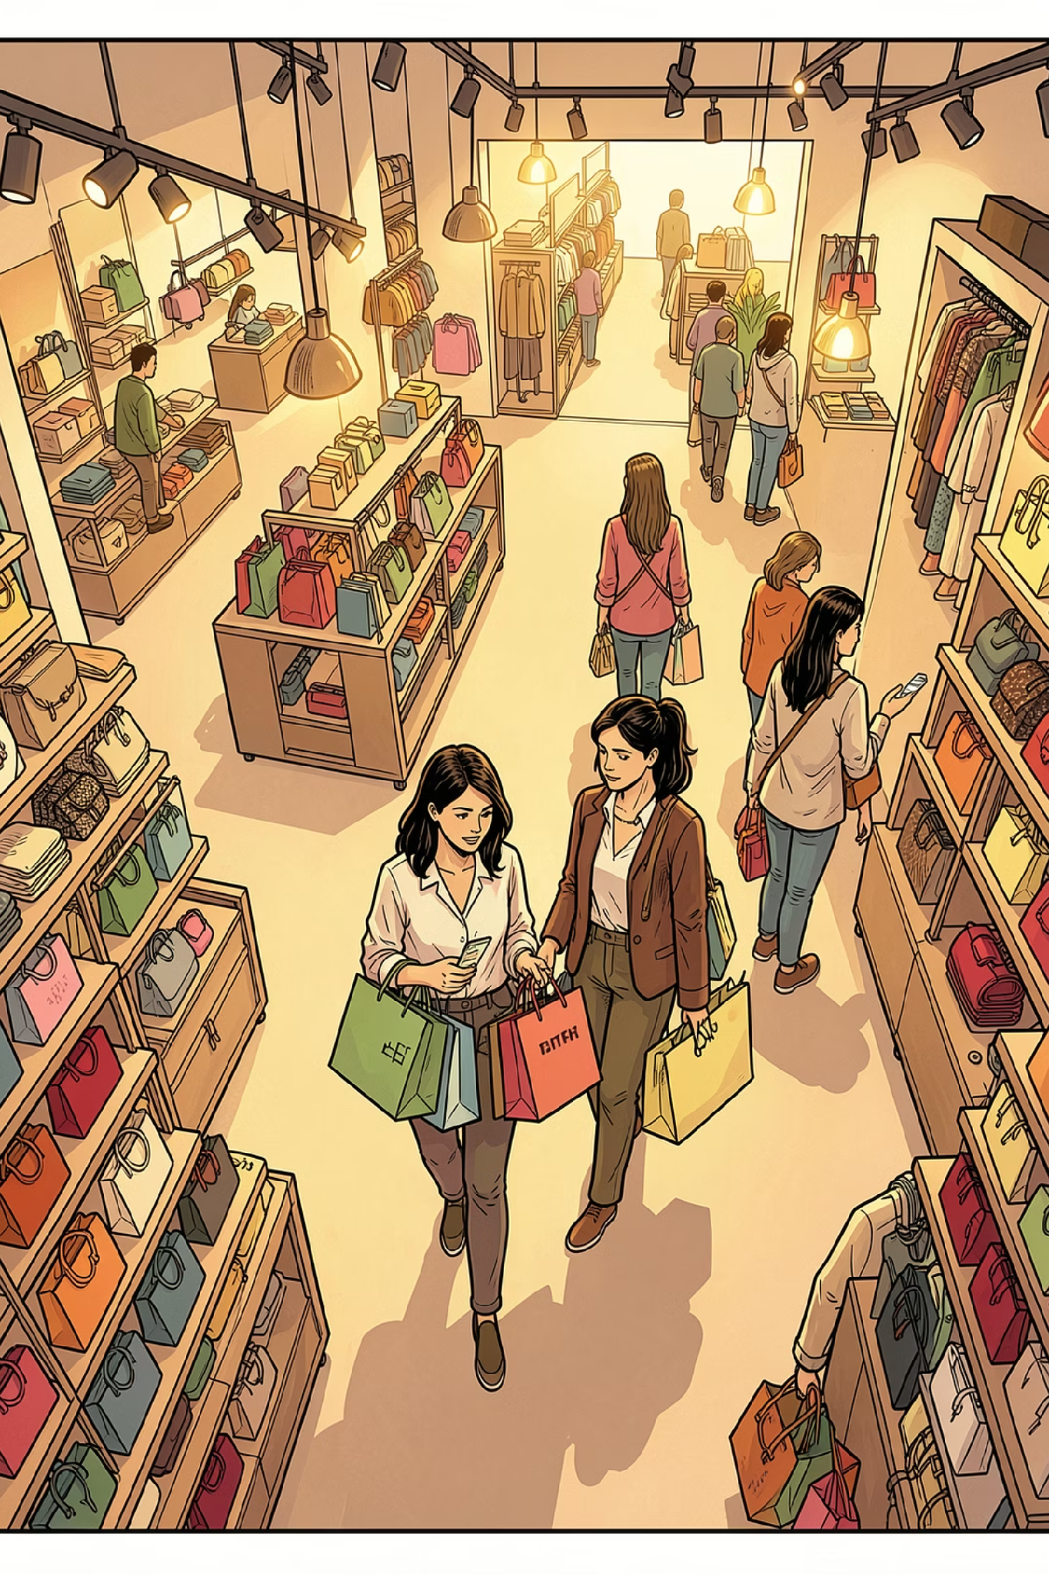
Customer Shopping Behavior Analysis
Uncovering insights from 3,900 transactions across product categories — spending patterns, customer segments, and subscription behavior.

Slide 2
Dataset at a Glance
3,900
18
Transactions
Features
Rows in the dataset
Columns of data
$59.76
37
Avg Purchase
Missing Values
Average spend per order
In Review Rating column
Customers aged 18–70 with data spanning demographics, purchase details, and shopping behavior.

Slide 3
Key Data Features
Demographics
Purchase Details
Shopping Behavior
Age, Gender, Location, Subscription Status
Item, Category, Amount, Season, Size, Color
Discount, Promo Code, Frequency, Review Rating, Shipping Type

Slide 4

Python: Data Preparation & Cleaning
01
Load & Explore
Imported via pandas; used df.info() and .describe() for structure and summary stats.
02
Handle Missing Data
Imputed missing Review Ratings using the median rating per product category.
03
Standardize & Engineer
Renamed columns to snake_case; created age_group bins and purchase_frequency_days.
04
Load to PostgreSQL
Dropped redundant promo_code_used; connected to PostgreSQL for SQL analysis.

Slide 5
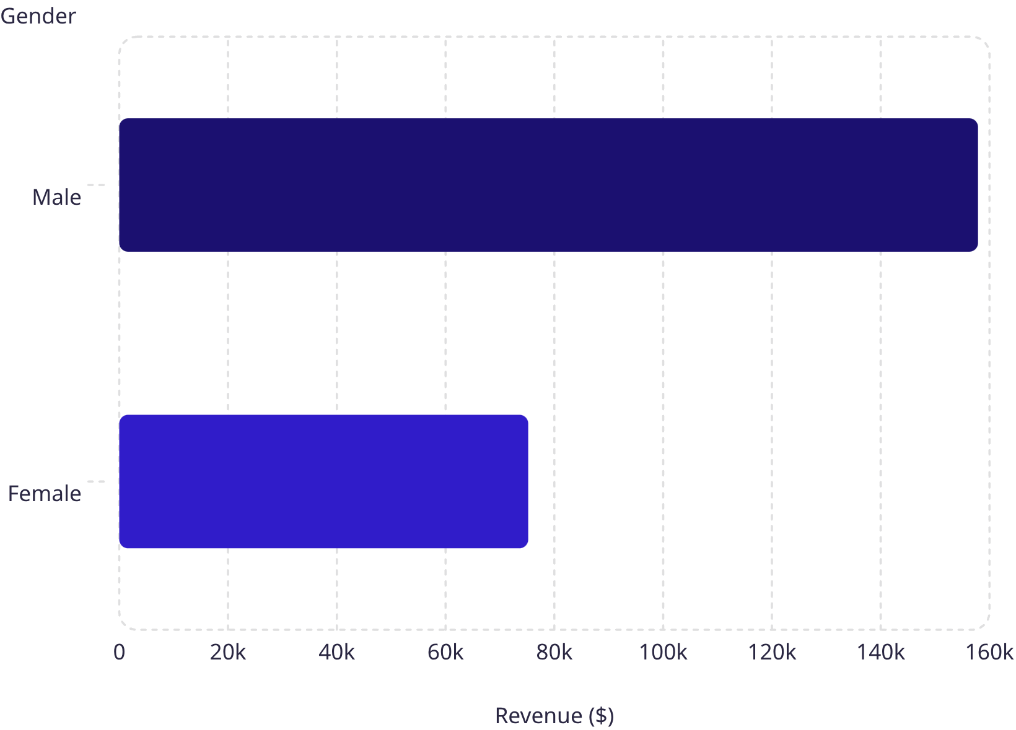
Revenue by Gender & Shipping Type
Key Findings
Male customers generated $157,890 — more than double female revenue at $75,191.
Shipping type analysis compared average purchase amounts between Standard and Express options to understand spend behavior by delivery preference.

Slide 6
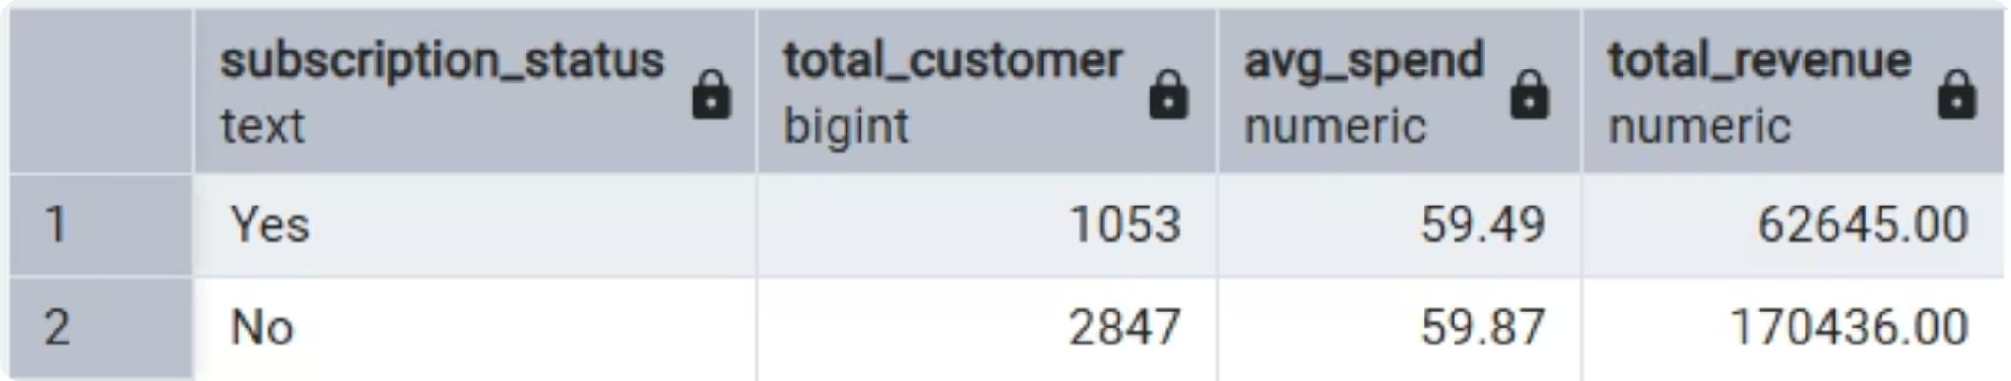

Subscribers vs. Non-Subscribers & Repeat Buyers
Subscription Insights
Compared average spend and total revenue across subscription status. Customers with more than 5 purchases were analyzed to determine whether repeat buyers are more likely to subscribe.
Repeat purchase frequency is a strong signal for subscription conversion potential.

Slide 7
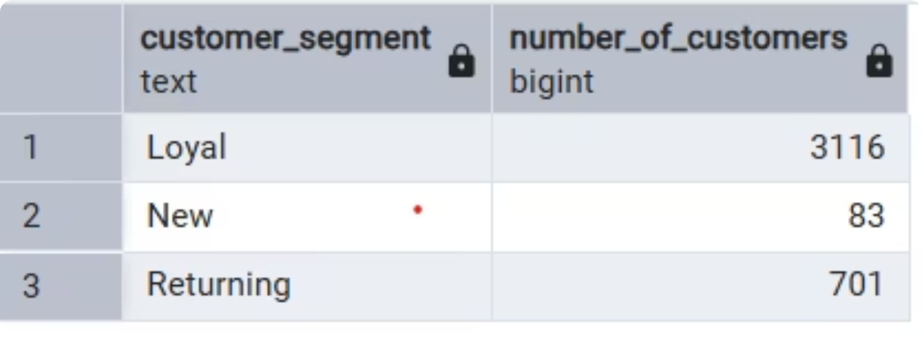
Customer Segmentation & Age Group Revenue
Three Customer Segments
Customers classified as New, Returning, or Loyal based on purchase history.
Revenue by Age Group
Total revenue contribution calculated per age group to identify highest-value demographics for targeted marketing.

Slide 8
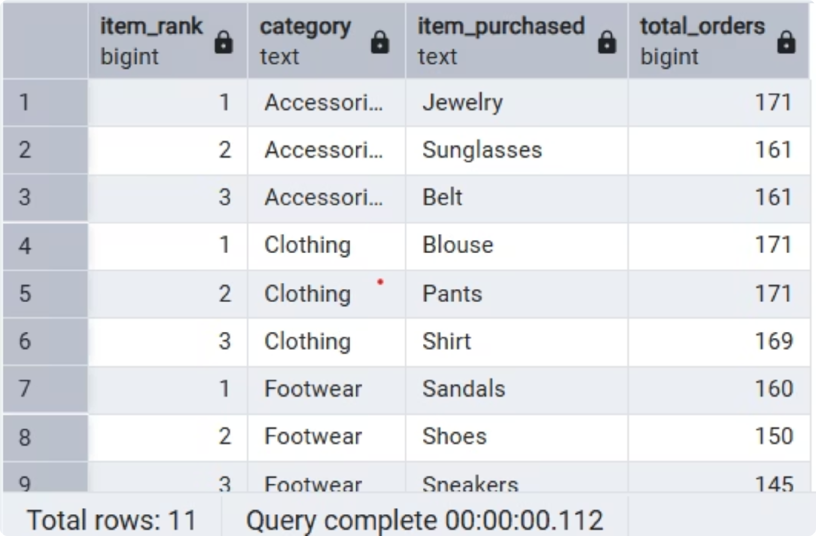
Top Products: Ratings & Category Leaders
Top 5 Products by Rating
Products with the highest average review ratings were identified to guide product positioning in campaigns.
Top 3 Products per Category
Most purchased products listed within each category to highlight best-sellers for marketing focus.

Slide 9
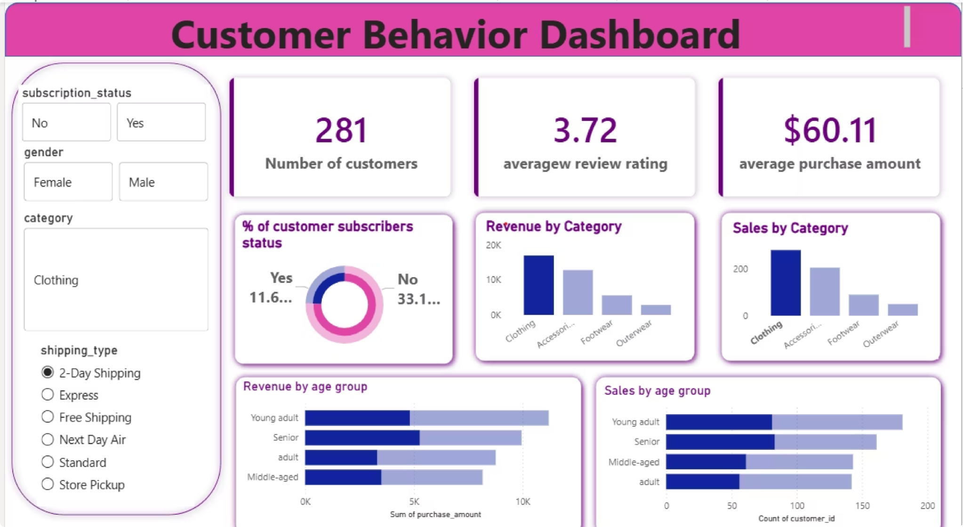
Power BI Dashboard
An interactive Power BI dashboard was built to present all insights visually — enabling stakeholders to explore revenue, segments, product performance, and subscription trends at a glance.

Slide 10

Business Recommendations
Boost Subscriptions
Loyalty Programs
Review Discount Policy
Promote exclusive subscriber benefits to drive conversion.
Reward repeat buyers to move them into the "Loyal" segment.
Balance sales boosts with margin control for discount users.
Product Positioning
Targeted Marketing
Highlight top-rated and best-selling products in campaigns.
Focus on high-revenue age groups and express-shipping users.

